Slide 1
Meeting 31/10/2019
Andrew Fraser-Harris, Stuart Gilfillan, Christopher McDermott, Mylene Receveur

Slide 2
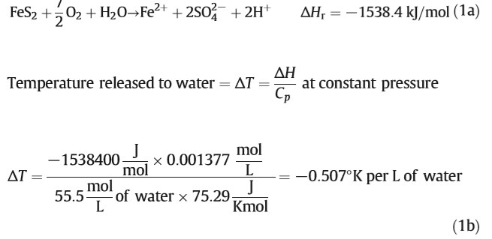
Summary meeting 23/09/2019
Addressed points | Progress 30/10/2019
Characterize sources of heat in mines: Local heat production linked to the type/volume of surrounding rock type Fluid flow/upflow along deep faults Zones of conductive/convective heat transfers Chemical reactions in mines (exothermic reactions) Realize a conceptual model of the mines (~800 m deep) : identify the main sources of heat + expected mine geometry depending on the mining method Focus research on Midlothian, Middle Valley Coalfield (East MVS) Model the potential impact of seasonal temperature variations on shallow subsurface temperature (i.e. depth of influence, contribution of solar input in GSHP schemes) Scientific guidance for the licensing of heat (i.e. terms of the water-heat access agreement) | Draw cross-sections + cross-analysis with depth of temperature measurements → statistical analysis (need more data from Coal Authority) See conceptual models Case-study specific (requires geochemical analysis?) See conceptual models Other possible case studies (see report from meeting w/ Ian) - Mine water scheme in Dawdon/Hawthorn/Seaham (pumping since 2004/2008 + new heat scheme in Dec. 2019) - Lanchester (has been using heat from loop system for 6 months (only 1 MW extracted over 4 MW planned) → + heat replenishment, recharge from shallow zone/outcrops, advection of water, change in geothermal gradient resulting from mine-water extraction/injection, time for new equilibrium to be reached, heat scheme sustainability, (…)
Textbook / references Minewater hydrology textbook (ref: Younger et al., 2002) Banks, D. 2008. Thermogeology: Ground Source Heating and Cooling. | Borrowed from library
Next: Skills to acquire: Numerical modelling Meeting at the Coal authority CASE placement Get in touch with David Manning, Newcastle University | Tutorial Hydrology 2 (GMSH and OpenGeoSys) Meeting with Ian on the 07/10/2019 January Meeting 29/10/2019

Slide 3
Summary meeting at Coal Authority, Mansfield Office, 07/10/2019
Meeting Jeremy Crooks, Head of Innovation
Data overview with Ian
Layers of Data accessible at http://mapapps2.bgs.ac.uk/coalauthority/home.html + Inferis intranet at the Coal Authority
Shafts (geometry and current state) → look at heat transfer above filled shafts
Underground workings (seam codes, thickness, type, depth), based on 1 x 2 km digitalized mine plans (more information available on original Mine Plan maps).
3D view at Bilston Glen
Spotheight: seam level (floor level, OD)
Roadways (may represent major flow path at the bottom of shafts). Unlicensed data > 25 yrs old
Monitoring points (outflow, temperature).
Coal seams outcrops
Geological disturbances
Shallow coal (<30 m) + buffer indicating collapse hazards (i.e. Blindwells site: opencast in East Lothian Coalfield)
Mine abandonment Plans (nVision internal system at the Coal Authority)
BGS paper to be published in December (correlation between 100 yrs old rock temperature and current water temperature in the mine)
Monitoring data: data available at 260 locations currently being reported in a Summary Excel Sheet (min/max temperature, flow rates at shaft, depth to water…).
Temperature
Temperature VS time (i.e. Junkies outflow). Continuous logging only at a few sites
Temperature/conductivity VS depth (i.e. ETC log, can be repeated over time)
Water level logger: inform on the temperature at the depth of the sensor BUT no information on the depth of the sensor. Can inform on seasonal changes in temperature.
Manual measurements
Pumping tests: step by step increase/decrease in pumping rates over long time periods (6 months – x years) until equilibrium between water recovery/pumping rate is reached

Slide 4
Suggested conceptual models

Slide 5
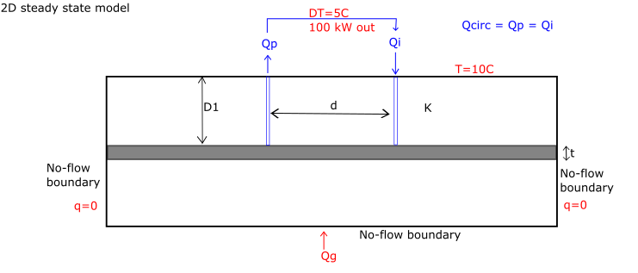
2D steady state model
Simulate heat extraction from a single seam with no net inflow / outflow to determine the new steady state heat flow pattern from the surface, together with the lateral extent of the zone influences by mine water extraction.
Geometry
Sensitivity analysis on the model width necessary to determine the minimum lateral extent required to minimize edge effects of the no flow/flux boundaries on the model temperature
D =100 m [100 – 500 m?]
d =100 m [100 - 1000 m?]
t = 2m
n (seam porosity) = 50%
Boundary conditions:
Borehole abstraction/reinjection modelled as from one cell or as lines
Properties: K (thermal conductivity of sandstone/mudstone)
Questions: To which depth does solar input and/or long-term surface temperature changes affect sub-surface temperature / geothermal gradient?
How does the geothermal gradient re-equilibrate as a result of mine water heat extraction/injection scheme?
What are the effects of seasonal production?

Slide 6
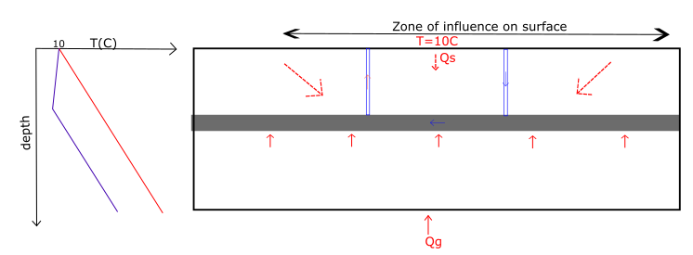
Expected results:
Decrease in seam temperature due to the reinjection of colder mine water
Increase in conductive heat exchanges between the host rock (geothermal heat recharge from below) and the coal seam
Possible negative gradient formed above the coal seam leading to solar heat flux flowing down from the surface
New steady state reached between solar/geothermal heat recharge and colder water injection (balance + location of solar/geothermal fluxes is of interest)
The difference between the undisturbed thermal profile (in red) and the new steady state (in blue) represents the heat energy extracted prior to sustainable steady state being reaches (heat mining)

Slide 7
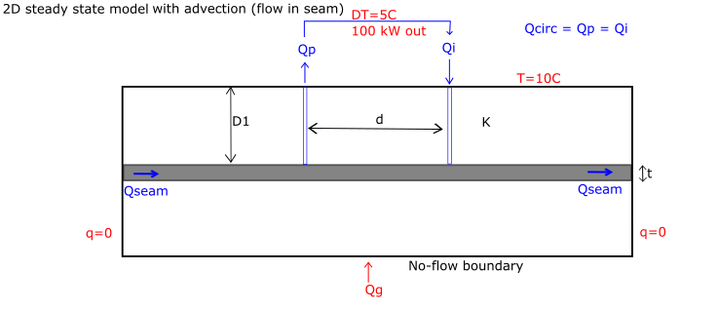
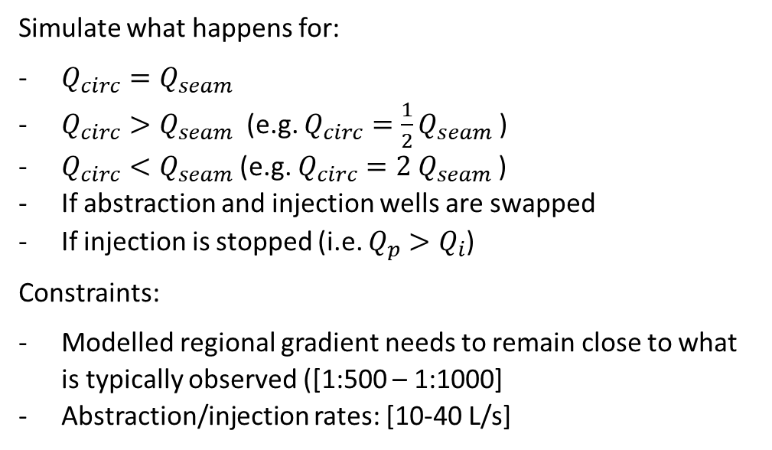
2D steady state model with flow in seam
Regional head gradient is set across width of the model.
Simulate what happens for:
$Q_{circ}=Q_{seam}$
$Q_{circ}>Q_{seam}$ (e.g. $Q_{circ}=\frac{1}{2}Q_{seam}$)
$Q_{circ}<Q_{seam}$(e.g. $Q_{circ}=2 Q_{seam}$)
If abstraction and injection wells are swapped
If injection is stopped (i.e. $Q_{p}>Q_{i}$)
Constraints:
Modelled regional gradient needs to remain close to what is typically observed ([1:500 – 1:1000]
Abstraction/injection rates: [10-40 L/s]

Slide 8
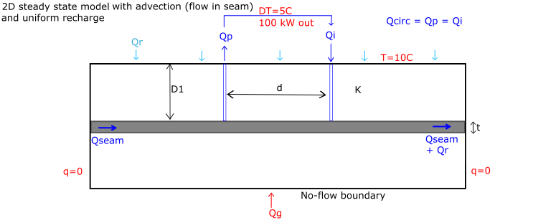
2D steady state model with flow in seam and uniform recharge
Flow is induced both along the seam (horizontal flow mainly) and the host rock / strata (vertical flow mainly).
Question: Does the adjective heat flow from surface in the recharge make a significant difference?

Slide 9
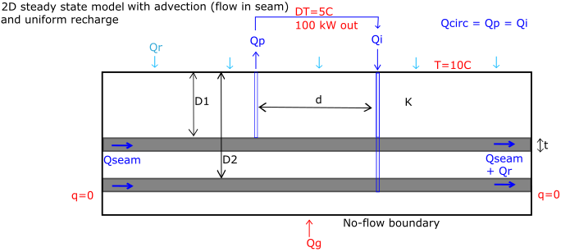
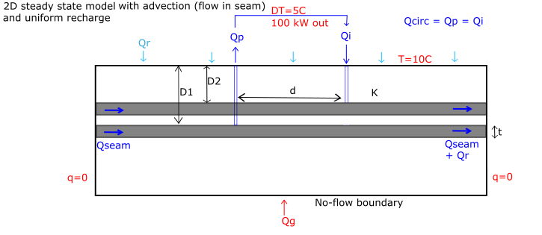
2D steady state model with flow in seam and uniform recharge + other features
Seam below (+ reinjection)
Seam above (+reinjection)
+
Interconnections between seams?
Infilled mine shaft close to the boreholes
Solar seasonal fluctuations?
Different mined seam geometries (e.g. goaf / open voids)
does the number of coal seam affect heat storage/recharge rate ?

Slide 10
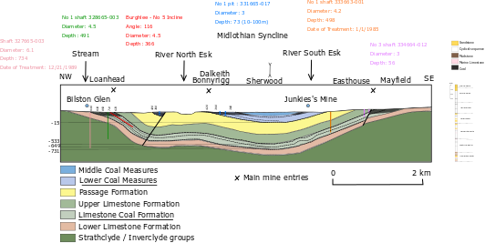
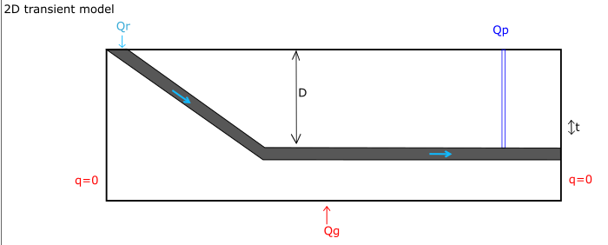
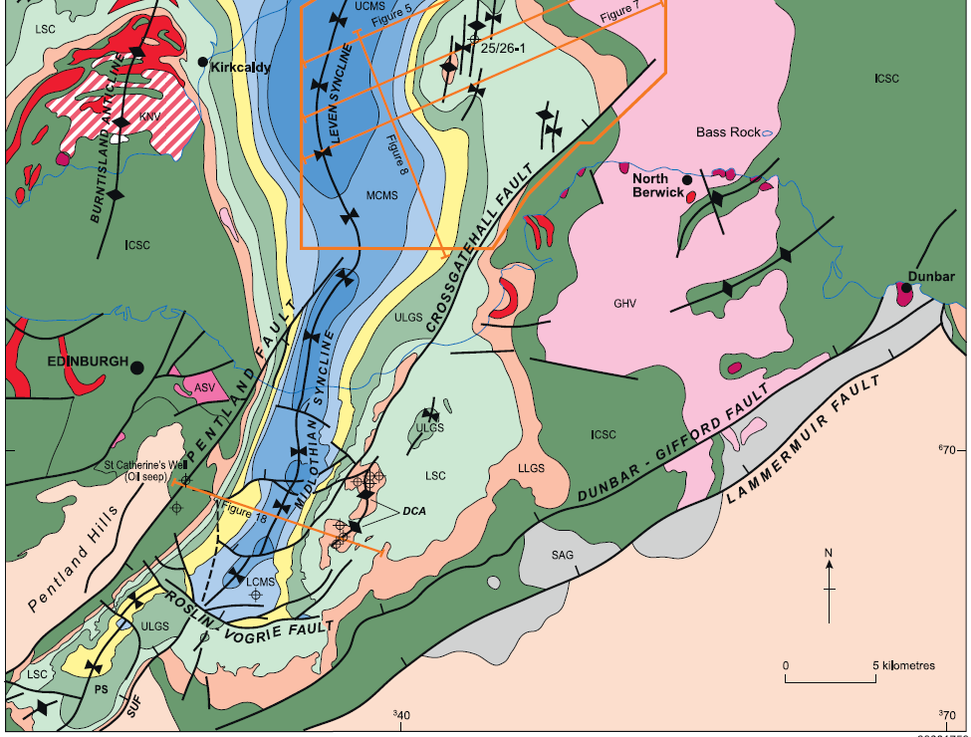
Transient model
Objective: determine the time to reach the new steady state or breakthrough time.
Underhill et al., 2018
Geometry: include more realistic geometry such as a dipping layer / seam from outcrop (i.e. Bilston glen, Dawdon and Hawthorne areas) allowing recharge to flow down.
Question: can the temperature of Q be predicted by modelling?
How local geology / mine workings geometry affects mine water temperature (i.e. recharge/infiltration rate, water-rock heat transfers)

Slide 11
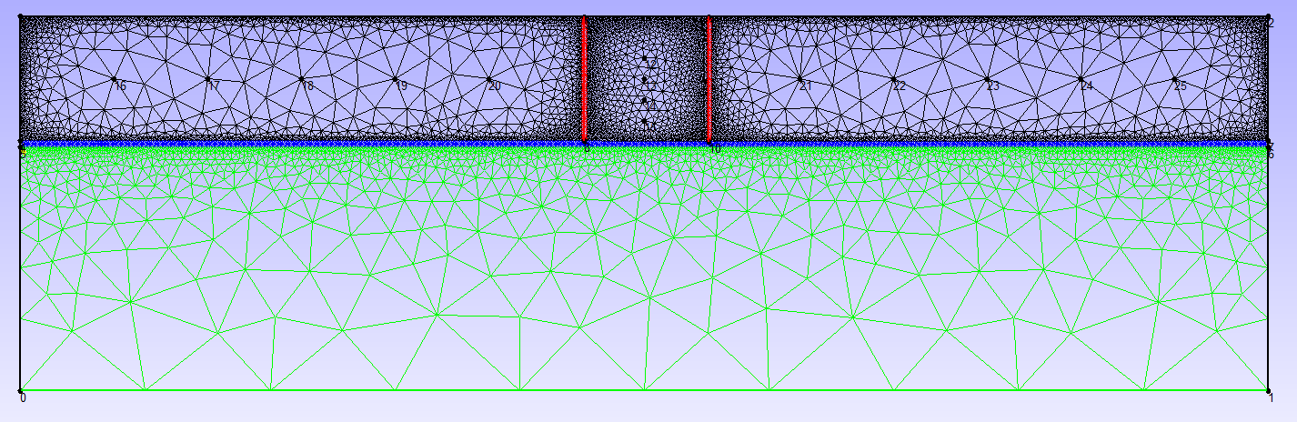
Numerical approach
Production =
Injection rate
Tinj = 15C
??
Constant temperature (10C) + No flow hydraulic BC
No flow BCs
Or constant head ? i.e. 100m
No flow BCs
Or constant head ? i.e. 100m
Initial conditions:
Constant Temperature (i.e. 20C)
+ Constant head (i.e. 100m) ?
Constant thermal flux + No flow hydraulic BC
Group | 0 | 1 | 2 | 3
Medium | TOP | WORKING | BOTTOM | WELLS
Porosity | 0.05 | 0.25 | 0.05 | 1
Tortuosity | 1 | 1 | 1 | 1
Storage (specific storage, m-1) if transient | 1.00E-05 | 2.00E-04 | 1.00E-05 | 0.00E+00
permeability tensor (hydraulic conductivity, m/s) | 4.50E-05 | 2.30E-02 | 4.50E-05 | 1.00E+00
mass dispersion | 0 | 0 | 0 | 0
→ Do not work, check input files

Slide 12
Literature review

Slide 13
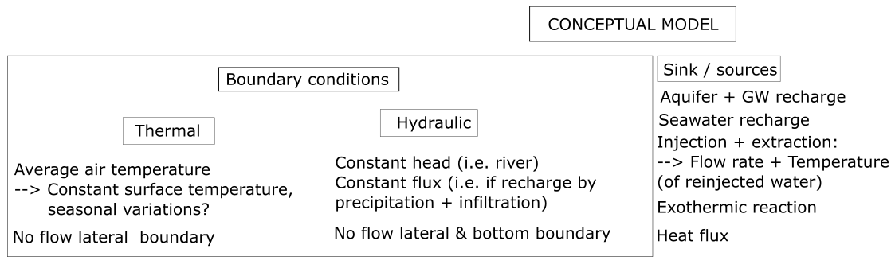
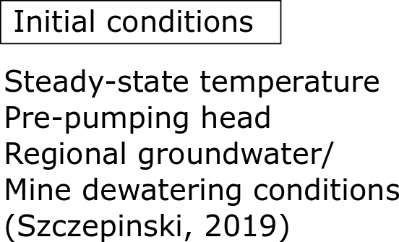
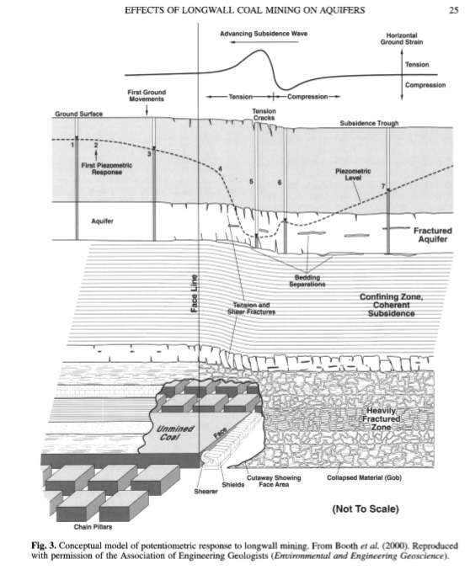
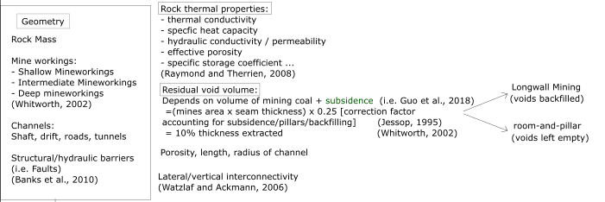



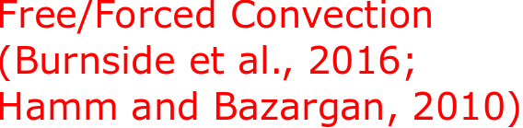
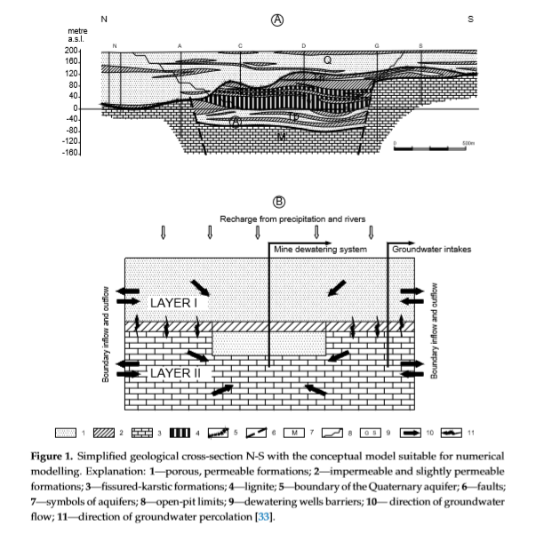
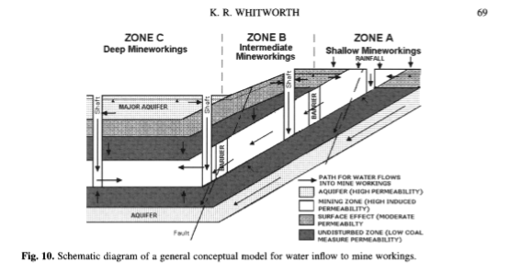
Conceptual models
BOOTH, C.J., 2002
Szczepinski, 2019

Slide 14
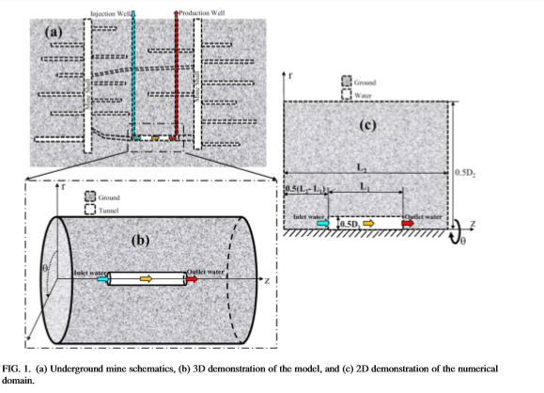
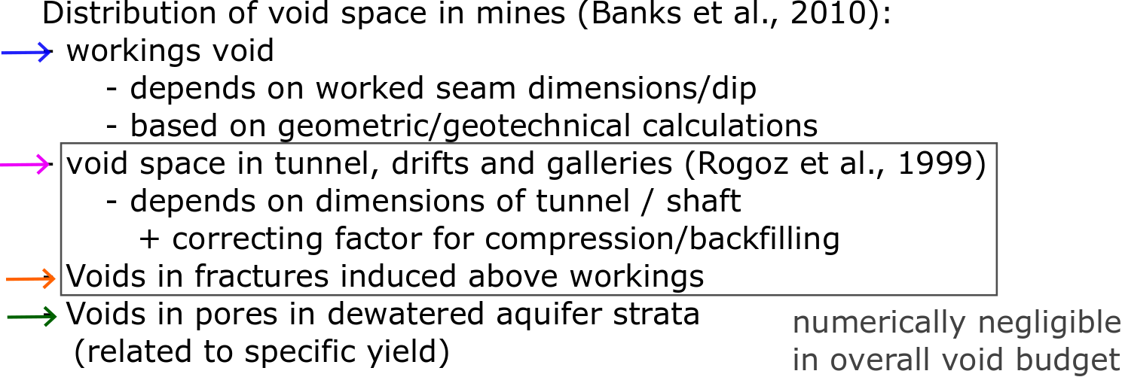
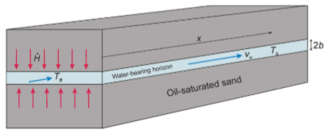
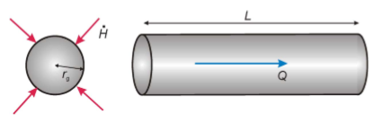
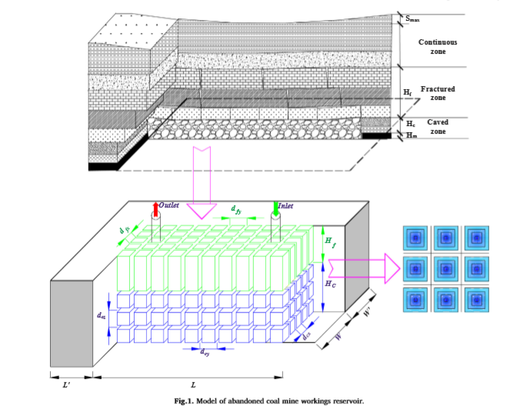
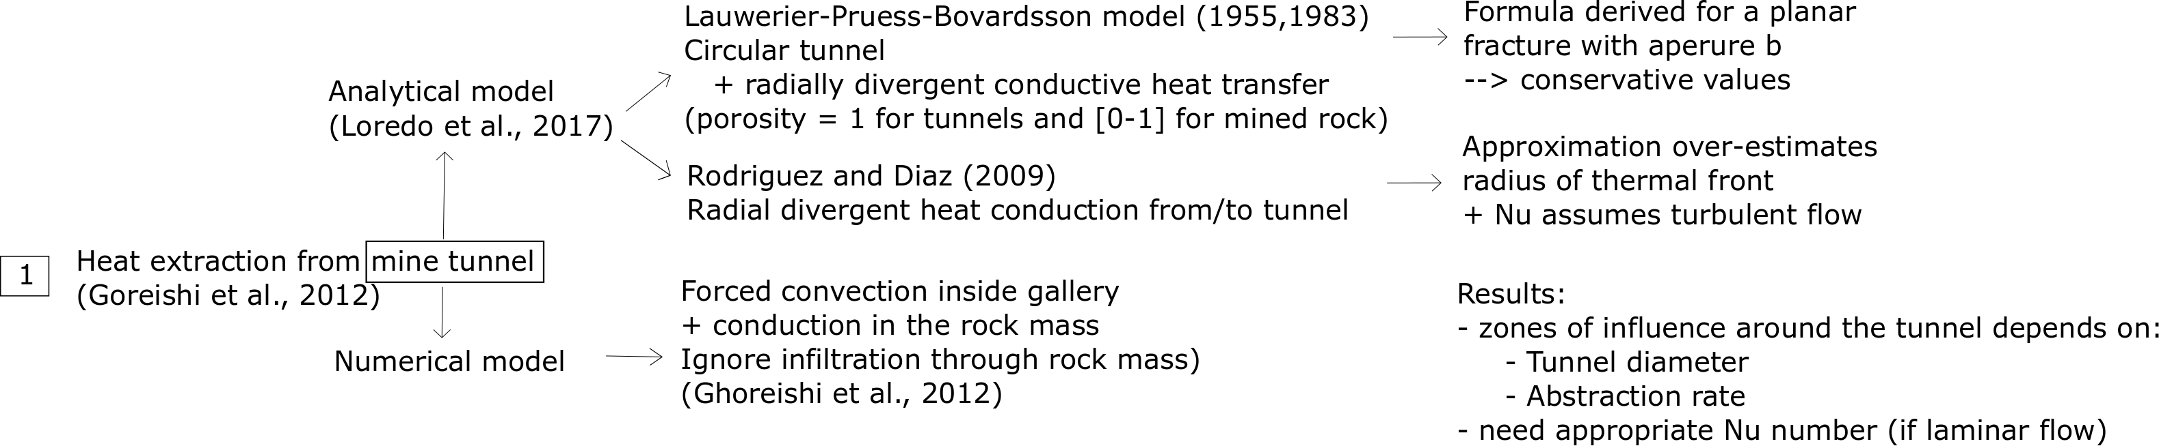
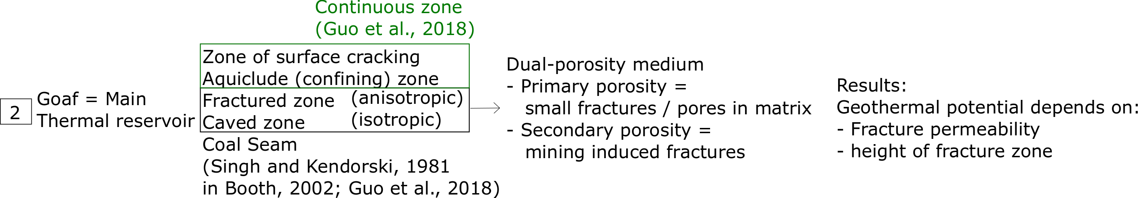
Numerical models
Analytical Models
Mine tunnels
Ghoreishi et al., 2012
Loredo et al., 2017
Mine workings
Guo et al., 2018

Slide 15
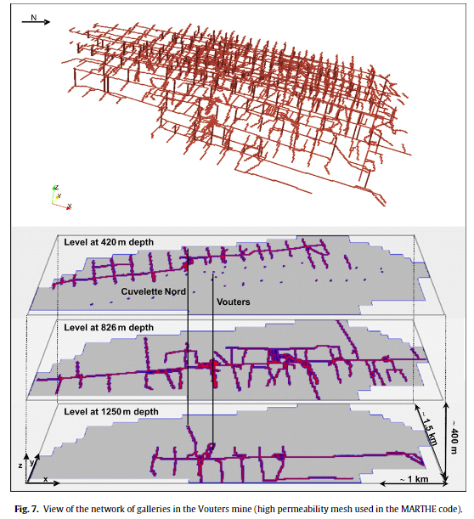
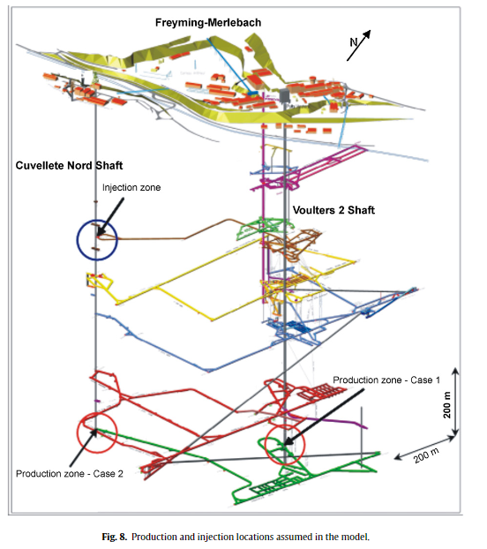
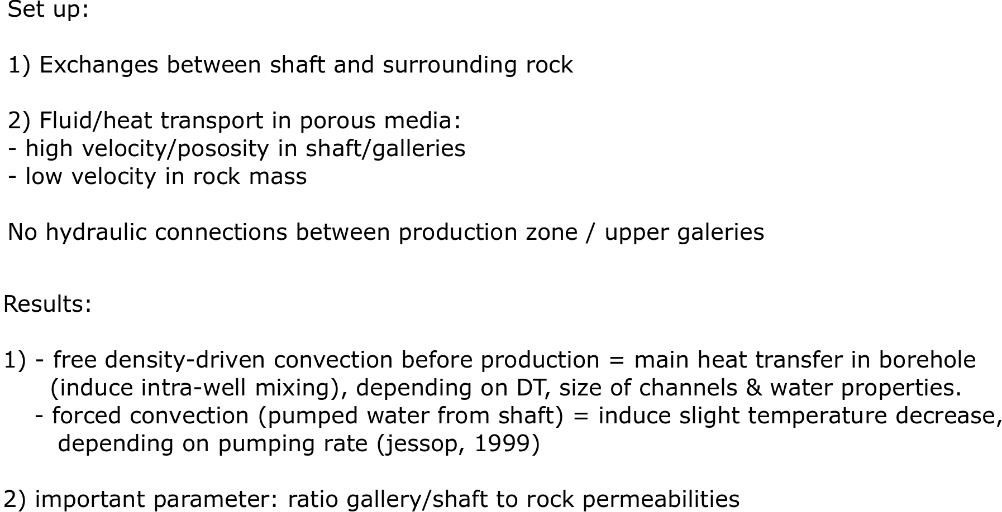
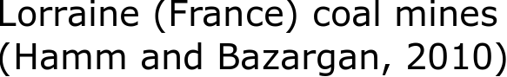
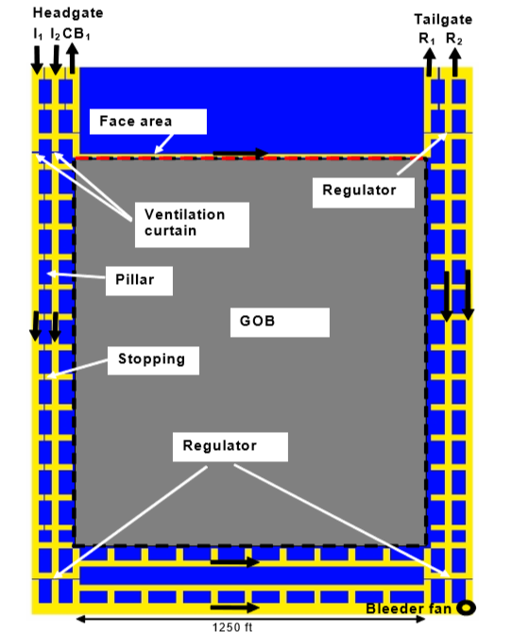
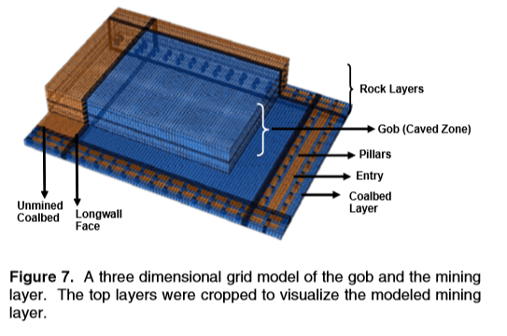
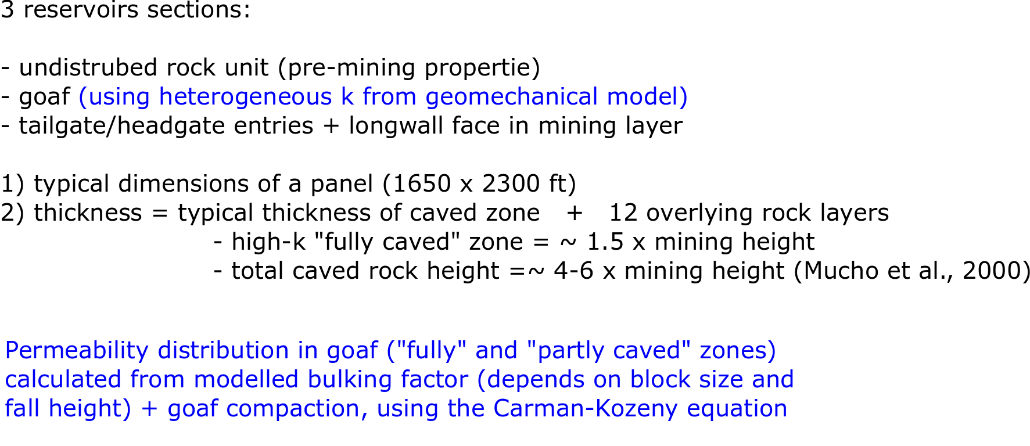
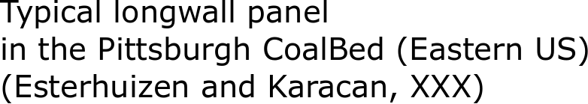
3D Numerical models: Case study

Slide 16
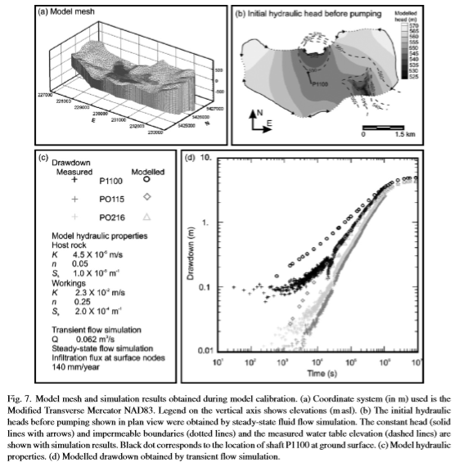
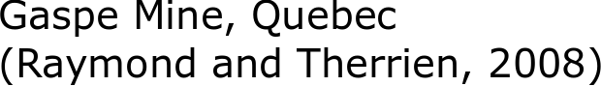
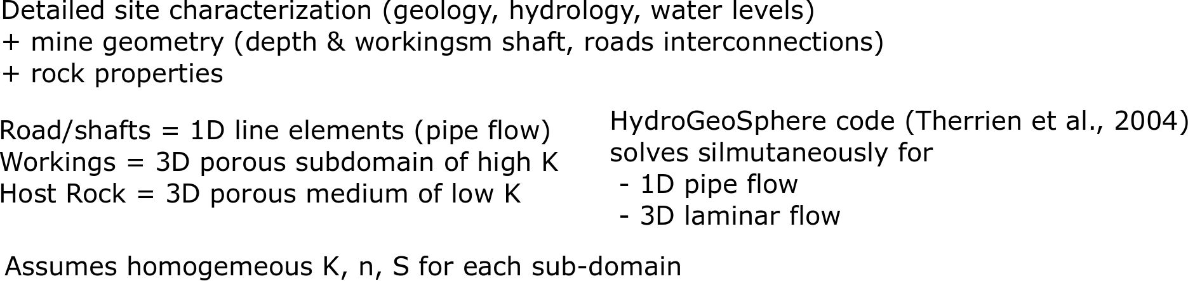
3D Numerical models: Case study
What more can be brought compared to Raymond and Therrien (2008) model ? (i.e. model does not consider fracture zone, whereas height of fracture zone has proved to be essential by Guo et al (2018)
+ use corrected geothermal gradient as initial conditions ?

Slide 17
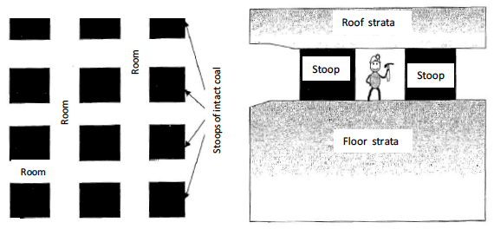
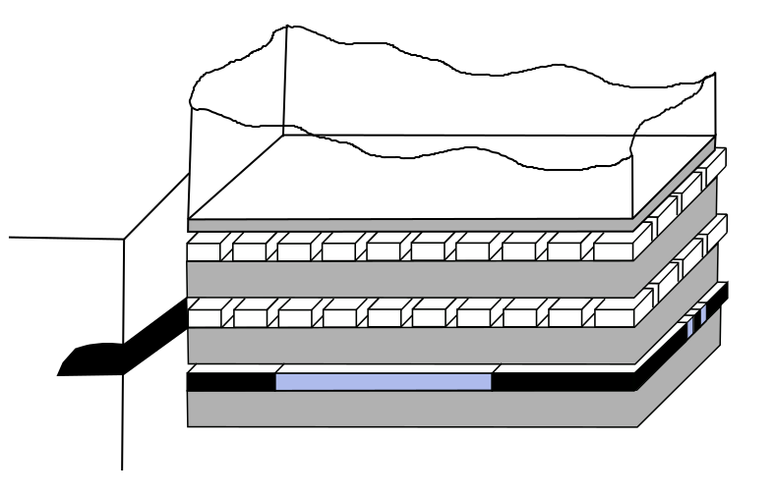
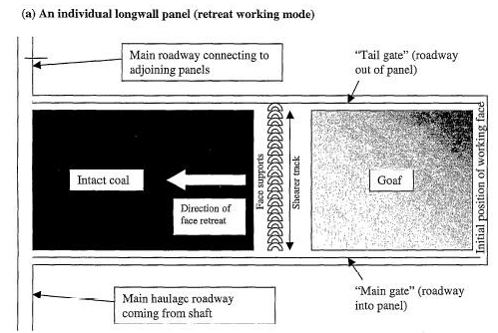
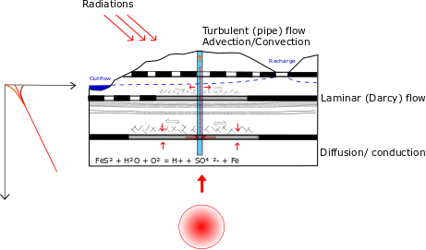
Summary

Slide 18
Research question: toward confirmation report
Topic of research: “Conceptualize Mine-water temperature” (thanks Fiona)
Main research question: Why different mines have different temperatures?
What is to be found ?
What is the main control on mine-water temperature
The extent / zone of influence of the heat supply around the well
The heat storage/recharge mechanisms in a mine under reinjection scheme
The impact of solar energy
What is one reason this research matters to the field:
Predictive tool to assess sustainability of heat supply from mine water
Guide the licensing of heat
Suggested chapters
I. Conceptual model, mathematical approach, sensitivity analysis.
→ Where does the heat comes from ?
II. Case study (i.e. Midlothian) : calibration and validation of model.
→ What is the extent of the zone of influence of heat mining? What are the recharge mechanisms ?
III. Why different mines have different temperatures ?
→ compare modeling results from different mines in the UK with different geometries (validate model)
IV. Conclusion: Can the model used as a predictive tool and how can it guide the licensing of heat ?
Required data:
Case study to be selected if sufficient amount of data available
(i.e. temperature profiles, temporal evolution of surface / bottom-hole temperatures,
+ discharge / flow rate with seasonal variations) + geothermal potential in the area
Chemical analysis + maps of recharge / discharge area of coal mine water to determine water origin (BC of the models)
High-resolution heat flow maps (identify potential anomalies)
Flooding history/pumping tests (pumping rates for mines having a remedial scheme)

Slide 19
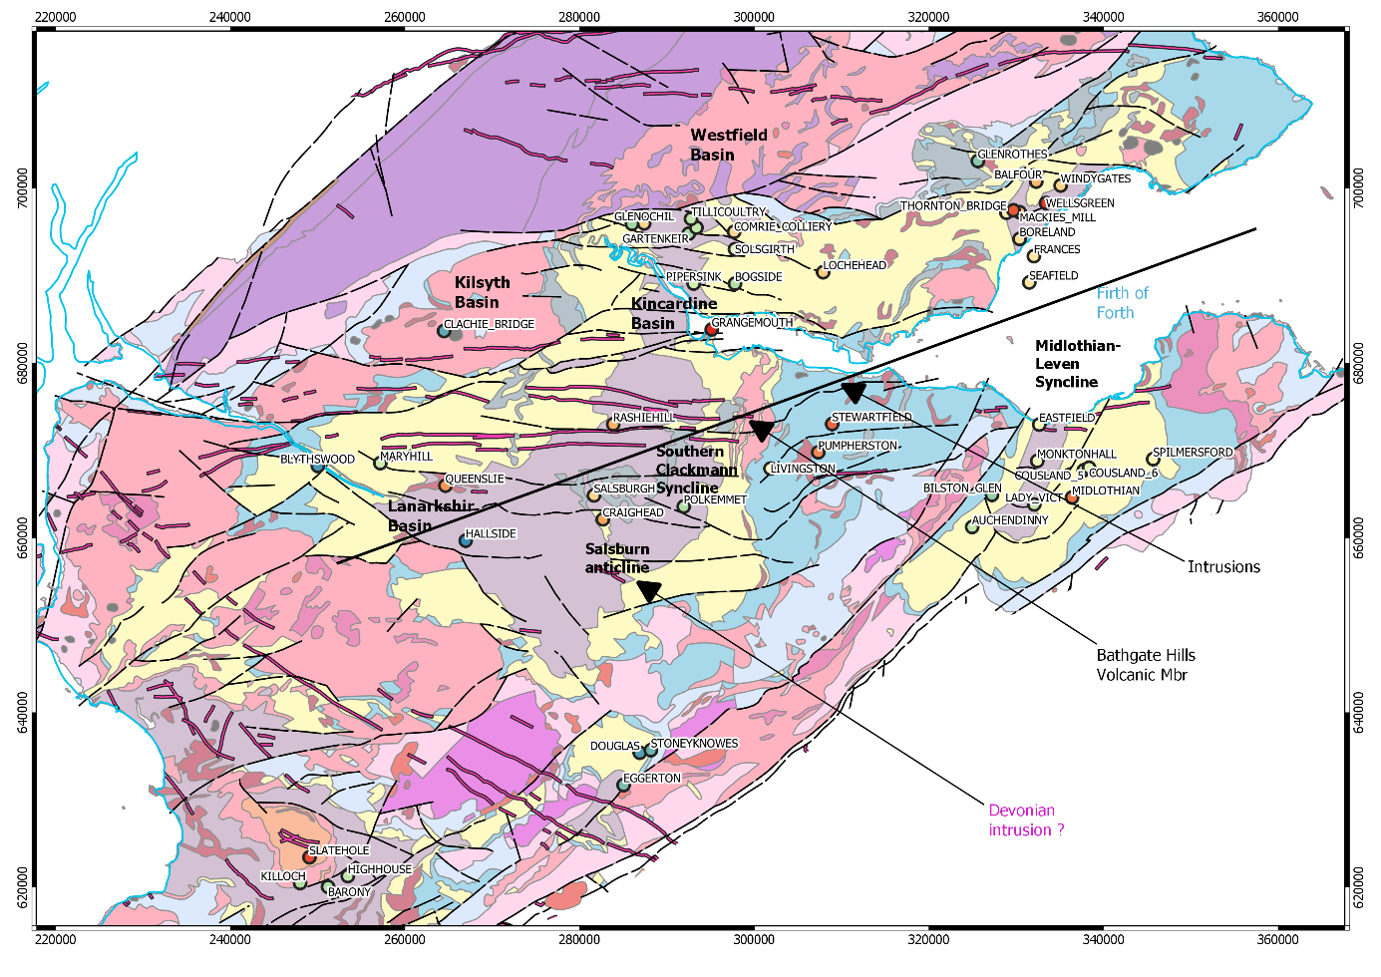
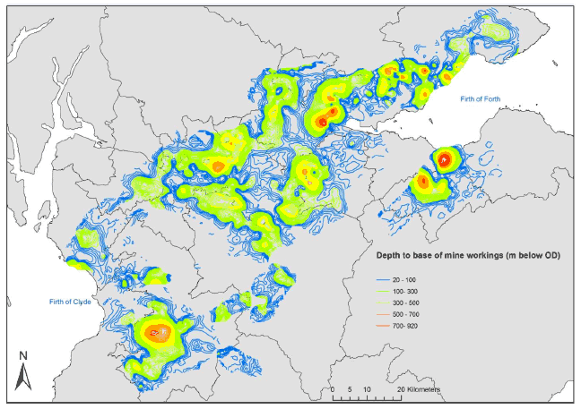
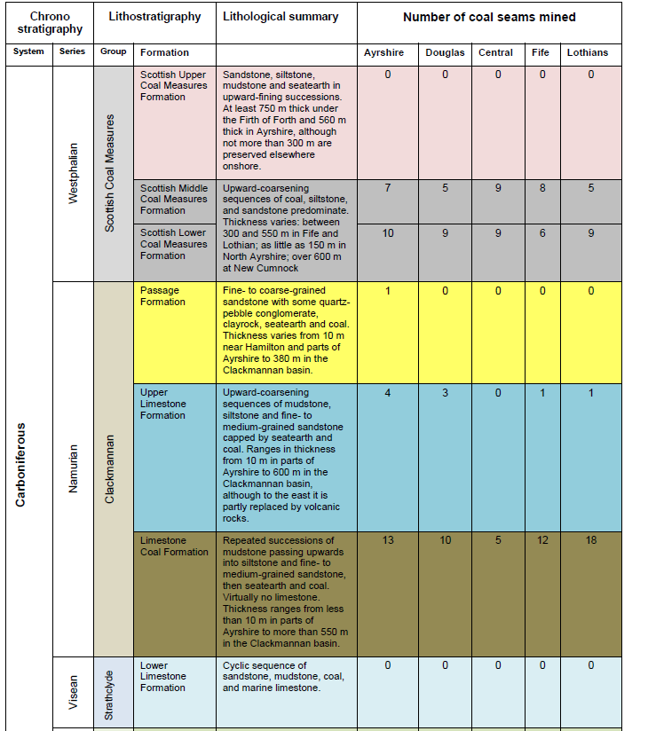
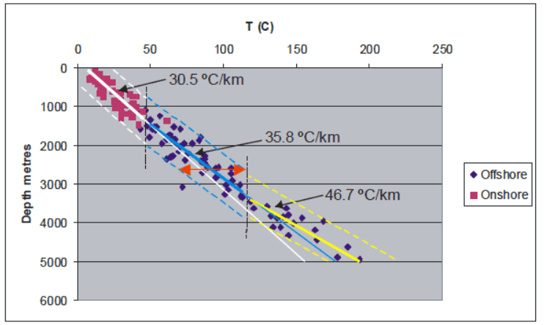
Comparison between mines
Rock type | Character | K (W/m/K) | Reference
sandstone | sedimentary | 3.3-4.9 | Lee et al., 1984
mudstone | sedimentary | 1.5-2.2 | Lee et al., 1984
limestone | sedimentary | 2.8-3.0 | Lee et al., 1984
coal | sedimentary | 0.31 | Lee et al., 1984
slate (metamudstone) | metamorphic | 2.7 | Lee et al., 1984
basement metasediment | metamorphic | 3.51 | Lee et al., 1984
basement metasediment | metamorphic | 3.1-3.5 | Wheildon et al., 1984
granite | igneous | 3.0-3.5 | Wheildon et al., 1984
granodiorite and tonalite | igneous | 2.5-2.9 | Wheildon et al., 1984
dolerite and basalt | igneous | 2.2 | Lee et al., 1984
peridotite | igneous | 2.2 | Wheildon et al., 1984

Slide 20
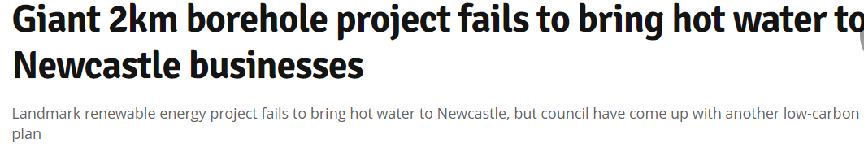
Next
Meeting 29/10/2019, David manning, Stuart
New 2km deep borehole near Newcastle
Potential data sources: Lanchester Wines, UK Geo Glasgow Observatory
Visit of open pit mine
73 C water.
London Conference: https://www.geolsoc.org.uk/GSL-7th-London-Geothermal-Symposium

Slide 21
References
Adams, C, J Gluyas, and A Monaghan. ‘Mining for Heat’. Geoscientist 29, no. 4 (1 May 2019): 10–15. https://doi.org/10.1144/geosci2019-021.
Bailey, M.T., C.J. Gandy, I.A. Watson, L.M. Wyatt, and A.P. Jarvis. ‘Heat Recovery Potential of Mine Water Treatment Systems in Great Britain’. International Journal of Coal Geology 164 (July 2016): 77–84. https://doi.org/10.1016/j.coal.2016.03.007.
Banks, David. An Introduction to Thermogeology: Ground Source Heating and Cooling. Oxford, UK: Blackwell Publishing, Ltd, 2008. https://doi.org/10.1002/9781444302677.
Banks, David, Adam Frolik, Grzegorz Gzyl, and Marek Rogoż. ‘Modeling and Monitoring of Mine Water Rebound in an Abandoned Coal Mine Complex: Siersza Mine, Upper Silesian Coal Basin, Poland’. Hydrogeology Journal 18, no. 2 (March 2010): 519–34. https://doi.org/10.1007/s10040-009-0534-z.
Booth, C.J. ‘The Effects of Longwall Coal Mining on Overlying Aquifers’. In Mine Water Hydrogeology and Geochemistry, Younger, El & Robins, N.S., 198. Geological Society, London, Special Publications., 2002.
Burnside, N.M., D. Banks, and A.J. Boyce. ‘Sustainability of Thermal Energy Production at the Flooded Mine Workings of the Former Caphouse Colliery, Yorkshire, United Kingdom’. International Journal of Coal Geology 164 (July 2016): 85–91. https://doi.org/10.1016/j.coal.2016.03.006.
Esterhuizen, Gabriel, and C. Karacan. ‘A METHODOLOGY FOR DETERMINING GOB PERMEABILITY DISTRIBUTIONS AND ITS APPLICATION TO RESERVOIR MODELING OF COAL MINE LONGWALLS’, 1 January 2007.
Esterhuizen, G.S, and C.O Karacan. ‘Development of Numerical Models to Investigate Permeability Changes and Gas Emission around Longwall Mining Panel’, n.d., 13.
Farr, Gareth, Sivachidambaram Sadasivam, Manju, Ian.A. Watson, Hywel.R. Thomas, and David Tucker. ‘Low Enthalpy Heat Recovery Potential from Coal Mine Discharges in the South Wales Coalfield’. International Journal of Coal Geology 164 (July 2016): 92–103. https://doi.org/10.1016/j.coal.2016.05.008.
Gillespie, M.R, E.J Crane, and H.F Barron. Study into the Potential for Deep Geothermal Energy in Scotland, Scottish Government Project. AECOM, BGS. Vol. AEC/001/11, 2013.
Guo, Pingye, Liange Zheng, Xiaoming Sun, Manchao He, Yanwei Wang, and Jingshi Shang. ‘Sustainability Evaluation Model of Geothermal Resources in Abandoned Coal Mine’. Applied Thermal Engineering 144 (November 2018): 804–11. https://doi.org/10.1016/j.applthermaleng.2018.06.070.
Hall, Andrew, John Ashley Scott, and Helen Shang. ‘Geothermal Energy Recovery from Underground Mines’. Renewable and Sustainable Energy Reviews 15, no. 2 (February 2011): 916–24. https://doi.org/10.1016/j.rser.2010.11.007.
Hamm, V, and B Bazargan Sabet. ‘Modelling of Fluid Flow and Heat Transfer to Assess the Geothermal Potential of a Flooded Coal Mine in Lorraine, France | Elsevier Enhanced Reader’. Geothermics 39 (2010): 177–86. https://doi.org/10.1016/j.geothermics.2010.03.00.
Jessop. ‘GEOTHERMAL ENERGY FROM OLD MINES AT SPRINGHILL, NOVA SCOTIA, CANADA’, 1999.
Kolditz, Olaf, Uwe-Jens Görke, Hua Shao, Wenqing Wang, and Sebastian Bauer, eds. Thermo-Hydro-Mechanical-Chemical Processes in Fractured Porous Media: Modelling and Benchmarking: Benchmarking Initiatives. Terrestrial Environmental Sciences. Cham: Springer International Publishing, 2016. https://doi.org/10.1007/978-3-319-29224-3.
Loredo, C., N. Roqueñí, and A. Ordóñez. ‘Modelling Flow and Heat Transfer in Flooded Mines for Geothermal Energy Use: A Review’. International Journal of Coal Geology 164 (July 2016): 115–22. https://doi.org/10.1016/j.coal.2016.04.013.
Loredo, Covadonga, David Banks, and Nieves Roqueñí. ‘Evaluation of Analytical Models for Heat Transfer in Mine Tunnels’. Geothermics 69 (1 September 2017): 153–64. https://doi.org/10.1016/j.geothermics.2017.06.001.
Madiseh, S A Ghoreishi, Mory M Ghomshei, F P Hassani, and F Abbasy. ‘Sustainable Heat Extraction from Abandoned Mine Tunnels: A Numerical Model’. J. Renewable Sustainable Energy, 2012, 17.
Majorowicz, Jacek, William Gosnold, Donald Gray, Jan Safanda, Robert Klenner, and Martyn Unsworth. ‘Implications of Post-Glacial Warming for Northern Alberta Heat Flow— Correcting for the Underestimate of the Geothermal Potential’, Vol. 36, 2012.
Monaghan, Alison. The Carboniferous Shales of the Midland Valley of Scotland: Geology and Resource Estimation, 2014. https://www.ogauthority.co.uk/onshore/onshore-reports-and-data/reports-bgs-midland-valley-of-scotland-shale/.
Nicholson, M. ‘Bilston Glen No.1 DC Shaft Survey’, 2019.
Raymond, Jasmin, and René Therrien. ‘Low-Temperature Geothermal Potential of the Flooded Gaspé Mines, Québec, Canada’. Geothermics 37, no. 2 (April 2008): 189–210. https://doi.org/10.1016/j.geothermics.2007.10.001.
Szczepiński, Jacek. ‘The Significance of Groundwater Flow Modeling Study for Simulation of Opencast Mine Dewatering, Flooding, and the Environmental Impact’. Water 11, no. 4 (23 April 2019): 848. https://doi.org/10.3390/w11040848.
Todd, Fiona, Christopher McDermott, Andrew Fraser Harris, Alexander Bond, and Stuart Gilfillan. ‘Coupled Hydraulic and Mechanical Model of Surface Uplift Due to Mine Water Rebound: Implications for Mine Water Heating and Cooling Schemes’. Scottish Journal of Geology, 26 July 2019, sjg2018-028. https://doi.org/10.1144/sjg2018-028.
Underhill, John R., Alison A. Monaghan, and Mike A.E. Browne. ‘Controls on Structural Styles, Basin Development and Petroleum Prospectivity in the Midland Valley of Scotland’. Marine and Petroleum Geology 25, no. 10 (December 2008): 1000–1022. https://doi.org/10.1016/j.marpetgeo.2007.12.002.
Whitwork, K.R. ‘The Monitoring and Modelling of Mine Water Recovery in UK Coalfields’. In Mine Water Hydrogeology and Geochemistry, Youger, El & Robins, N.S., 198. Geological Society, London, Special Publications., 2002.
Younger, Paul L., S. A. Banwart, and Robert S. Hedin. Mine Water: Hydrology, Pollution, Remediation. Springer Science & Business Media, 2012.

